Slide 1
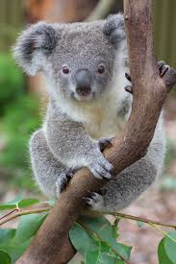
Koala Evolution
By: Tiffany Chen and Joyce Huang

Slide 2
Meet the Koala Family!

Slide 3
Background
Life span: 20 years
Diet: Herbivore
Location: Eastern Australia
Status: Endangered; Threatened

Slide 4
Diet, pics, habitat, location of habitat, evolution, carnivore, herbivore, omnivore…
Lifespan
Evolution changes
Endangered?

